Slide 1
Lecture 3
SQL

Slide 2
Outline
Create/Drop/Alter Tables
Basic Query Structure
Set Operations
Aggregation Functions
Recursive Queries
Complex Queries
Views

Slide 3
History
IBM Sequel language developed as part of System R project at the IBM San Jose Research Laboratory
Renamed Structured Query Language (SQL)
ANSI and ISO standard SQL
  SQL-92
  SQL:1999 (language name became Y2K compliant!)
  SQL:2003
Commercial systems offer most, if not all, SQL-92 features, plus varying feature sets from later standards and special proprietary features.
  Not all examples here may work on your particular system.

Slide 4
Data Definition Language
Allows the specification of not only a set of relations but also information about each relation, including:
  The schema for each relation.
  The domain of values associated with each attribute.
  Integrity constraints
  The set of indices to be maintained for each relations.
  Security and authorization information for each relation.
  The physical storage structure of each relation on disk.

Slide 5
Create Table Construct
An SQL relation is defined using the create table command:
create table r (A₁ D₁, A₂ D₂, ..., A_{n} D_{n},
(integrity-constraint₁),
...,
(integrity-constraint_{k}))
  r is the name of the relation
  each A_{i} is an attribute name in the schema of relation r
  D_{i} is the data type of values in the domain of attribute A_{i}
Example:
create table instructor (
ID char(5),
name varchar(20),
dept_name varchar(20),
salary numeric(8,2))

Slide 6
Domain Types in SQL
char(n). Fixed length character string, with user-specified length n.
varchar(n). Variable length character strings, with user-specified maximum length n.
numeric(p,d). Fixed point number, with user-specified precision of p digits, with d digits to the right of decimal point.
int. Integer (a finite subset of the integers that is machine-dependent).
smallint. Small integer (a machine-dependent subset of the integer domain type).
real. Floating point and double-precision floating point numbers, with machine-dependent precision.
float(n). Floating point number, with user-specified precision of at least n digits.
……

Slide 7
Integrity Constraints in Create Table
not null
primary key (A₁, ..., A_{n} )
foreign key (A_{m}, ..., A_{n} ) references r
Example
create table instructor (
ID char(5),
name varchar(20) not null,
dept_name varchar(20),
salary numeric(8,2),
primary key (ID),
foreign key (dept_name) references department);
primary key declaration on an attribute automatically ensures not null

Slide 8
And a Few More Relation Definitions
create table student (
ID varchar(5),
name varchar(20) not null,
dept_name varchar(20),
tot_cred numeric(3,0),
primary key (ID),
foreign key (dept_name) references department);
create table takes (
ID varchar(5),
course_id varchar(8),
sec_id varchar(8),
semester varchar(6),
year numeric(4,0),
grade varchar(2),
primary key (ID, course_id, sec_id, semester, year) ,
foreign key (ID) references student,
foreign key (course_id, sec_id, semester, year) references section);
  Note: sec_id can be dropped from primary key above, to ensure a student cannot be registered for two sections of the same course in the same semester

Slide 9
And more still
create table course (
course_id varchar(8),
title varchar(50),
dept_name varchar(20),
credits numeric(2,0),
primary key (course_id),
foreign key (dept_name) references department);

Slide 10
Drop and Alter Table Constructs
drop table: deletes all information about the dropped relation from the database, incl. all tuples, constraints, relation itself
  drop table r
alter table:
  Add attributes to an existing relation:
    alter table r add A D
    All tuples in the relation are assigned null as the value for the new attribute.
  Drop attributes of a relation:
alter table r drop A
    Dropping of attributes not supported by some databases
    Syntax may differ among different implementations
  Modify constraints
    alter table r add primary key (A, B)
    alter table r drop primary key

Slide 11
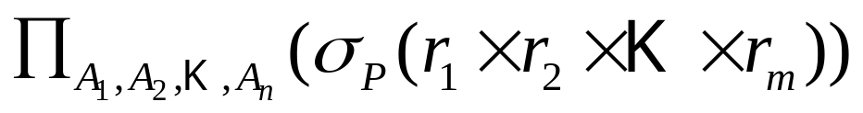
Basic Query Structure
A typical SQL query has the form:
select A₁, A₂, ..., A_{n}
from r₁, r₂, ..., r_{m}
where P
  A_{i} represents an attribute
  R_{i} represents a relation
  P is a predicate.
Equivalent relational algebra expression:
The result of an SQL query is a relation.
但是实际上还是有区别的，SQL语句允许得到重复元组，而代数表达式没有。

Slide 12
The select Clause
The select clause list the attributes desired in the result of a query
  corresponds to the projection operation of the relational algebra
Example: find the names of all instructors:
select name
from instructor
Relational algebra expression:
∏_{name} (instructor)
NOTE: SQL names are case insensitive
  E.g., Name ≡ NAME ≡ name
  Some people use upper case wherever we use bold font.

Slide 13
The select Clause (cont.)
SQL allows duplicates in relations as well as in query results.
To force the elimination of duplicates, insert the keyword distinct after select.
Example: Find the department names of all instructors, and remove duplicates
select distinct dept_name
from instructor
The keyword all specifies that duplicates not be removed.
select all dept_name
from instructor
默认不去除重复①性能考虑②对于count在一些情况下才是正确的。③直接去重可能有些现实实现完成不了

Slide 14
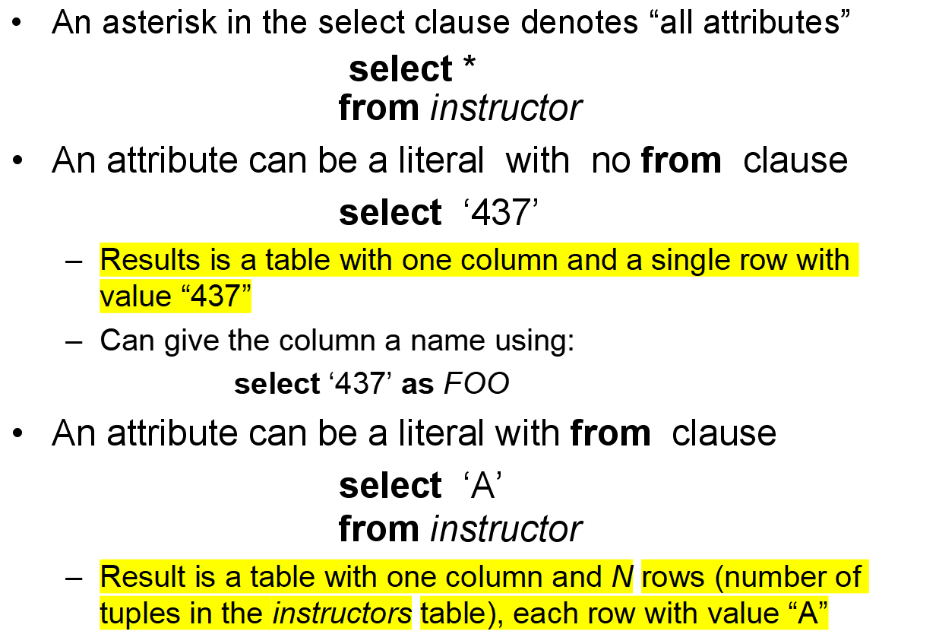
The select Clause (cont.)

Slide 15
The select Clause (cont.)
The select clause can contain arithmetic expressions involving the operation, +, –, ∗, and /, and operating on constants or attributes of tuples.
  select ID, name, salary/12
  from instructor
Can rename “salary/12” using the as clause:
  select ID, name, salary/12 as monthly_salary
  from instructor

Slide 16
The where Clause
The where clause specifies conditions that the result must satisfy
  Corresponds to the selection predicate of the relational algebra.
To find all instructors in Comp. Sci. dept
select name
from instructor
where dept_name = ‘Comp. Sci.'
Comparison results can be combined using the logical connectives and, or, and not.
  To find all instructors in Comp. Sci. dept with salary > 80000
  select name
  from instructor
  where dept_name = ‘Comp. Sci.' and salary > 80000
Comparisons can be applied to results of arithmetic expressions.

Slide 17
The where Clause (Cont.)
SQL includes a between comparison operator
Example: Find the names of those instructors with salary between $70,000 and $100,000 (that is, ≥ $70,000 and ≤ $100,000)
Tuple comparison
select name
from instructor
where salary between 70000 and 100000
  select name, course_id
  from instructor, teaches
  where (instructor.ID, dept_name) = (teaches.ID, ’Biology’);

Slide 18
The from Clause
The from clause lists the relations involved in the query
  Corresponds to the Cartesian product operation of the relational algebra.
Find the Cartesian product instructor X teaches
select ∗
from instructor, teaches
  generates every possible instructor – teaches pair, with all attributes from both relations.
  For common attributes (e.g., ID), the attributes in the resulting table are renamed using the relation name (e.g., instructor.ID)
Note: Result of Cartesian product can be large. Seldom do we use it directly.
    useful combined with where-clause condition

Slide 19



Cartesian Product
instructor
teaches

Slide 20
Examples
Find the names of all instructors who have taught some course and the course_id
  select name, course_id
  from instructor , teaches
  where instructor.ID = teaches.ID
Find the names of all instructors in the Art department who have taught some course and the course_id
  select name, course_id
  from instructor , teaches
  where instructor.ID = teaches.ID
  and instructor. dept_name = ‘Art’
索引？？？

Slide 21
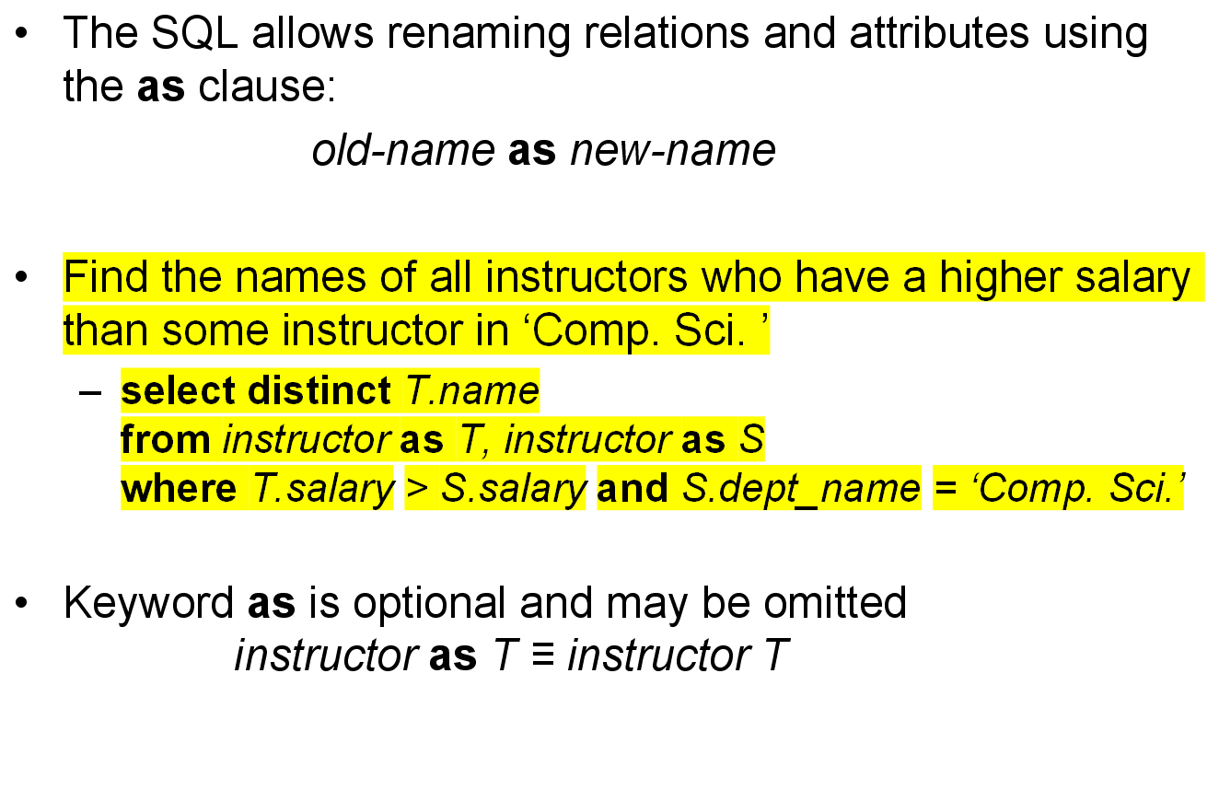
The Rename Operation

Slide 22
Self Join Example
Relation emp_super
person supervisor
Bob Alice
Mary Susan
Alice David
David Mary
Find the supervisor of “Bob”
Find the supervisor of the supervisor of “Bob”
Find ALL the supervisors (direct and indirect) of “Bob”

Slide 23
String Operations
字符串匹配运算符：like
  percent (%). The % character matches any substring.
  underscore (_). The _ character matches any character.
Find the names of all instructors whose name includes the substring “dar”.
select name
from instructor
where name like ‘%dar%’
  Match the name “100%”
like ‘100\%’ escape ‘\’
SQL supports a variety of string operations (functions)
  concatenation (using “||”)
  converting from upper to lower case (and vice versa)
  finding string length, extracting substrings, etc.

Slide 24
Ordering the Display of Tuples
List in alphabetic order the names of all instructors
select distinct name
from instructor
For each attribute:
desc for descending order;
asc for ascending order;
ascending order is the default.
  Example: order by name desc
Can sort on multiple attributes
  Example: order by dept_name, name
order by name

Slide 25
Duplicates
In relations with duplicates, SQL can define how many copies of tuples appear in the result.
Multiset versions of some of the relational algebra operators – given multiset relations r₁ and r₂:
  1. σ_{θ} (r₁): If there are c₁ copies of tuple t₁ in r₁, and t₁ satisfies selections σ_{θ,}, then there are c₁ copies of t₁ in σ_{θ} (r₁).
  2. Π_{A} (r ): For each copy of tuple t₁ in r₁, there is a copy of tuple Π_{A} (t₁) in Π_{A} (r₁) where Π_{A} (t₁) denotes the projection of the single tuple t₁.
  3. r₁ x r₂: If there are c₁ copies of tuple t₁ in r₁ and c₂ copies of tuple t₂ in r₂, there are c₁ x c₂ copies of the tuple t₁. t₂ in r₁ x r₂

Slide 26
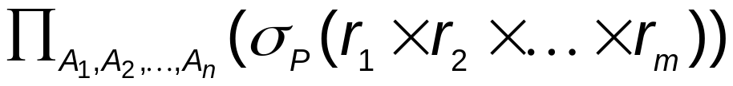
Duplicates (Cont.)
Example: Suppose multiset relations r₁ (A, B) and r₂ (C) are as follows:
r₁ = {(1, a) (2,a)} r₂ = {(2), (3), (3)}
Then Π_{B}(r₁) would be {(a), (a)}, while Π_{B}(r₁) x r₂ would be
{(a,2), (a,2), (a,3), (a,3), (a,3), (a,3)}
SQL duplicate semantics:
select A₁,, A₂, ..., A_{n}
from r₁, r₂, ..., r_{m}
where P
is equivalent to the multiset version of the expression:

Slide 27
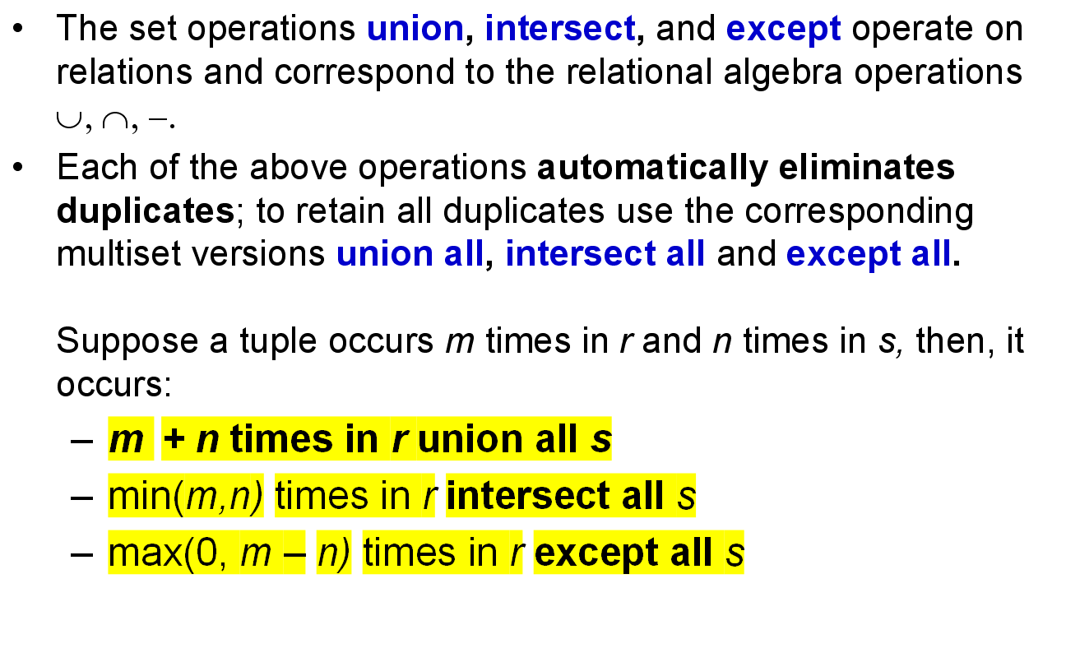
Set Operations

Slide 28
Set Operations
Find courses that ran in Fall 2009 or in Spring 2010
(select course_id from section where sem = ‘Fall’ and year = 2009)
union
(select course_id from section where sem = ‘Spring’ and year = 2010)
Find courses that ran in Fall 2009 and in Spring 2010
(select course_id from section where sem = ‘Fall’ and year = 2009)
intersect
(select course_id from section where sem = ‘Spring’ and year = 2010)
Find courses that ran in Fall 2009 but not in Spring 2010
(select course_id from section where sem = ‘Fall’ and year = 2009)
except
(select course_id from section where sem = ‘Spring’ and year = 2010)

Slide 29
Set Operations (Cont.)
Find the salaries of all instructors that are less than the largest salary.
  select distinct T.salary
  from instructor as T, instructor as S
  where T.salary < S.salary
Find all the salaries of all instructors
  select distinct salary
  from instructor
Find the largest salary of all instructors.
  (select “second query” )
  except
  (select “first query”)

Slide 30
Aggregate Functions
These functions operate on the multiset of values of a column of a relation, and return a value
avg: average value
min: minimum value
max: maximum value
sum: sum of values
count: number of values

Slide 31
Aggregate Functions (Cont.)
Find the average salary of instructors in the Computer Science department
  select avg (salary)
  from instructor
  where dept_name= ’Comp. Sci.’;
Find the total number of instructors who teach a course in the Spring 2010 semester
  select count (distinct ID)
  from teaches
  where semester = ’Spring’ and year = 2010;
Find the number of tuples in the course relation
  select count (*)
  from course;

Slide 32


Aggregate Functions – Group By
Find the average salary of instructors in each department
  select dept_name, avg (salary) as avg_salary
  from instructor
  group by dept_name;
avg_salary

Slide 33
Aggregation (Cont.)
Attributes in select clause outside of aggregate functions must appear in group by list
  /* erroneous query */
  select dept_name, ID, avg (salary)
  from instructor
  group by dept_name;

Slide 34
Aggregate Functions – Having Clause
Find the names and average salaries of all departments whose average salary is greater than 42000
select dept_name, avg (salary)
from instructor
group by dept_name
having avg (salary) > 42000;
Note: predicates in the having clause are applied after the
formation of groups whereas predicates in the where
clause are applied before forming groups

Slide 35
Aggregate Functions – Having Clause
Find the names and average salaries of all departments whose average salary is greater than $42000
select dept_name, avg (salary)
from instructor
group by dept_name
having avg (salary) > 42000
Note: Predicates in the having clause are applied after the
formation of groups whereas predicates in the where
clause are applied before forming groups

Slide 36
Null Values
It is possible for tuples to have a null value, denoted by null, for some of their attributes
null signifies an unknown value or that a value does not exist.
The predicate is null can be used to check for null values.
  Example: Find all loan number which appear in the loan relation with null values for amount.
select loan_number
from loan
where amount is null
The result of any arithmetic expression involving null is null
  Example: 5 + null returns null
However, aggregate functions simply ignore nulls
  More on next slide

Slide 37
Null Values and Three Valued Logic
Any comparison with null returns unknown
  Example: 5 < null or null <> null or null = null
Three-valued logic using the truth value unknown:
  OR: (unknown or true) = true, (unknown or false) = unknown
  (unknown or unknown) = unknown
  AND: (true and unknown) = unknown, (false and unknown) = false,
  (unknown and unknown) = unknown
  NOT: (not unknown) = unknown
  “P is unknown” evaluates to true if predicate P evaluates to unknown
Result of where clause predicate is treated as false if it evaluates to unknown

Slide 38
Null Values and Aggregates
Total all salaries
select sum (salary )
from instructor
  Above statement ignores null amounts
  Result is null if there is no non-null amount
All aggregate operations except count(*) ignore tuples with null values on the aggregated attributes.
  For example, when calculating avg(score), those who do not have a score (absent from the exam) are not taken into account.
  But count(score) will return total number of students, including those absent from the exam.

Slide 39
Nested Subqueries
SQL provides a mechanism for the nesting of subqueries.
A subquery is a select-from-where expression that is nested within another query.
The nesting can be done in the following SQL query
select A₁, A₂, ..., A_{n}
from r₁, r₂, ..., r_{m}
where P
as follows:
  A_{i} can be replaced be a subquery that generates a single value.
  r_{i} can be replaced by any valid subquery
  P can be replaced with an expression of the form:
  B <operation> (subquery)
  Where B is an attribute and <operation> to be defined later.

Slide 40
Subqueries in the Where Clause
A common use of subqueries is to perform tests:
  For set membership
  For set comparisons
  For set cardinality.

Slide 41
Set Membership
Find courses offered in Fall 2009 and in Spring 2010
select distinct course_id
from section
where semester = ’Fall’ and year= 2009 and
course_id in (select course_id
from section
where semester = ’Spring’ and year= 2010);
Find courses offered in Fall 2009 but not in Spring 2010
select distinct course_id
from section
where semester = ’Fall’ and year= 2009 and
course_id not in (select course_id
from section
where semester = ’Spring’ and year= 2010);

Slide 42
Set Membership (Cont.)
Find the total number of (distinct) students who have taken course sections taught by the instructor with ID 10101
select count (distinct ID)
from takes
where (course_id, sec_id, semester, year) in
(select course_id, sec_id, semester, year
from teaches
where teaches.ID= 10101);
Note: Above query can be written in a much simpler manner.
The formulation above is simply to illustrate SQL features.

Slide 43
Set Comparison – “some” Clause
Find names of instructors with salary greater than that of some (at least one) instructor in the Biology department.
select distinct T.name
from instructor as T, instructor as S
where T.salary > S.salary and S.dept_name = ’Biology’;
Same query using > some clause
select name
from instructor
where salary > some (select salary
from instructor
where dept_name = ’Biology’);

Slide 44
Definition of “some” Clause
F <comp> some r ⇔ ∃ t ∈ r such that (F <comp> t )
Where <comp> can be: <, ≤, >, =, ≠
0
(5 < some
5
) = true
(read: 5 < some tuple in the relation)
6
0
(5 < some
5
) = false
0
(5 = some
) = true
5
0
(5 ≠ some
5
) = true (since 0 ≠ 5)
(= some) ≡ in
However, (≠ some) ≡ not in

Slide 45
Set Comparison – “all” Clause
Find the names of all instructors whose salary is greater than the salary of all instructors in the Biology department.
select name
from instructor
where salary > all (select salary
from instructor
where dept name = ’Biology’);

Slide 46
Definition of all Clause
F <comp> all r ⇔ ∀ t ∈ r (F <comp> t)
0
(5 < all
5
) = false
6
6
(5 < all
) = true
10
4
(5 = all
) = false
5
4
(5 ≠ all
) = true (since 5 ≠ 4 and 5 ≠ 6)
6
(≠ all) ≡ not in
However, (= all) ≡ in

Slide 47
Test for Empty Relations
The exists construct returns the value true if the argument subquery is nonempty.
  exists r ⇔ r ≠ Ø
  not exists r ⇔ r = Ø

Slide 48
Use of “exists” Clause
Yet another way of specifying the query “Find all courses taught in both the Fall 2009 semester and in the Spring 2010 semester”
select course_id
from section as S
where semester = ’Fall’ and year = 2009 and
exists (select *
from section as T
where semester = ’Spring’ and year= 2010
and S.course_id = T.course_id);
Correlation name – variable S in the outer query
Correlated subquery – the inner query

Slide 49
Use of “not exists” Clause
Find all students who have taken all courses offered in the Biology department.
select distinct S.ID, S.name
from student as S
where not exists ( (select course_id
from course
where dept_name = ’Biology’)
except
(select T.course_id
from takes as T
where S.ID = T.ID));
First nested query lists all courses offered in Biology
Second nested query lists all courses a particular student took
Note that X – Y = Ø ⇔ X ⊆ Y

Slide 50
Test for Absence of Duplicate Tuples
The unique construct tests whether a subquery has any duplicate tuples in its result.
The unique construct evaluates to “true” if a given subquery contains no duplicates .
Find all courses that were offered at most once in 2008
  select T.course_id
  from course as T
  where unique (select R.course_id
  from section as R
  where T.course_id= R.course_id
  and R.year = 2008);

Slide 51
Subqueries in the Form Clause
SQL allows a subquery expression to be used in the from clause
Find the average instructors’ salaries of those departments where the average salary is greater than $42,000.”
  select dept_name, avg_salary
  from (select dept_name, avg (salary) as avg_salary
  from instructor
  group by dept_name)
  where avg_salary > 42000;
Note that we do not need to use the having clause, since we compute the temporary (view) relation in the from clause, and the attributes of avg_salary can be used directly in the where clause.

Slide 52
Subqueries in the Form Clause
Another way to write previous query
  select dept_name, avg_salary
  from (select dept_name, avg (salary)
  from instructor
  group by dept_name) as dept_avg (dept_name, avg_salary)
  where avg_salary > 42000;

Slide 53
With Clause
The with clause provides a way of defining a temporary view whose definition is available only to the query in which the with clause occurs.
Find all departments with the maximum budget
with max_budget (value) as
(select max(budget)
from department)
select department.name
from department, max_budget
where department.budget = max_budget.value;

Slide 54
Complex Query using With Clause
Find all departments where the total salary is greater than the average of the total salary at all departments
with dept _total (dept_name, value) as
(select dept_name, sum(salary)
from instructor
group by dept_name),
dept_total_avg(value) as
(select avg(value)
from dept_total)
select dept_name
from dept_total, dept_total_avg
where dept_total.value > dept_total_avg.value;

Slide 55
Subquery in the “select” Clause
Scalar subquery is one which is used where a single value is expected
List all departments along with the number of instructors in each department
select dept_name,
(select count(*)
from instructor
where department.dept_name = instructor.dept_name)
as num_instructors
from department;
Runtime error if subquery returns more than one result tuple

Slide 56
Modification of the Database
Deletion of tuples from a given relation.
Insertion of new tuples into a given relation
Updating of values in some tuples in a given relation

Slide 57
Modification of the Database – Deletion
Delete all instructors
delete from instructor
Delete all instructors from the Finance department
delete from instructor
where dept_name= ’Finance’;
Delete all tuples in the instructor relation for those instructors associated with a department located in the Watson building.
delete from instructor
where dept name in (select dept name
from department
where building = ’Watson’);

Slide 58
Deletion (Cont.)
Delete all instructors whose salary is less than the average salary of instructors
delete from instructor
where salary < (select avg (salary)
from instructor);
  Problem: as we delete tuples from deposit, the average salary changes
  Solution used in SQL:
  1. First, compute avg (salary) and find all tuples to delete
  2. Next, delete all tuples found above (without
  recomputing avg or retesting the tuples)

Slide 59
Modification of the Database – Insertion
Add all instructors to the student relation with tot_creds set to 0
insert into student
select ID, name, dept_name, 0
from instructor
The select from where statement is evaluated fully before any of its results are inserted into the relation.
Otherwise queries like
insert into table1 select * from table1
would cause problem

Slide 60
Modification of the Database – Updates
Increase salaries of instructors whose salary is over $100,000 by 3%, and all others by a 5%
  Write two update statements:
  update instructor
  set salary = salary * 1.03
  where salary > 100000;
  update instructor
  set salary = salary * 1.05
  where salary <= 100000;
  The order is important! (Why?)
  Can be done better using the case statement (next slide)

Slide 61
Case Statement for Conditional Updates
Same query as before: Increase salaries of instructors whose salary is over $100,000 by 3%, and all others by a 5%
update instructor
set salary = case
when salary <= 100000 then salary * 1.05
else salary * 1.03
end

Slide 62
Updates with Scalar Subqueries
Recompute and update tot_creds value for all students
update student S
set tot_cred = (select sum(credits)
from takes, course
where takes.course_id = course.course_id and
S.ID= takes.ID.and takes.grade <> ’F’ and
takes.grade is not null);
Sets tot_creds to null for students who have not taken any course
  Instead of sum(credits), use:
case
when sum(credits) is not null then sum(credits)
else 0
end

Slide 63
Appendix
Oracle and Database Development Toolkits
  Oracle installation and logical structure
  Query tips
  Oracle clients and development toolkits
    SQL*Plus
    Golden32
    PL/SQL Developer
    TOAD

Slide 64
Oracle installation
Oracle provides three installation modes
  Database server
  Oracle client
  Application developer
After a full installation the target system consists of
  A database server
  An Oracle client for management and application tools
  A database

Slide 65
Oracle installation
Installation procedure
  Follow the installation wizard
  Select installation mode
  Set system parameters
    Global database name
    SID – Identifies a database instance
  Wait for copying files and automatic configuration

Slide 66
Oracle installation
Configurations on Client
  Net Configuration Assistant
  Provides:
    Name of Oracle instance (SID)
    Remote Host, i.e. location of Oracle instance (service)
    Service Name
  Use “Net Configuration Assistant” or simply
  modify file “tnsnames.ora” (@database_home\NETWORK\ADMIN)

Slide 67
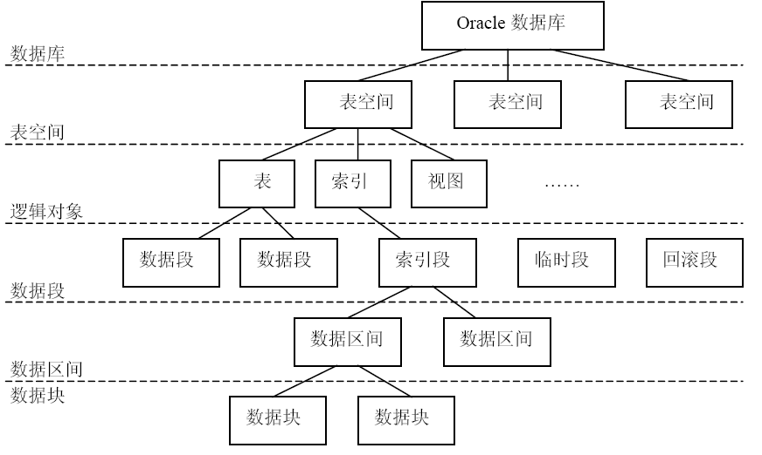
Oracle logical structure
Tablespaces
Tables, Indices, View…
Segments (data, indices, temporary, rollback)

Slide 68
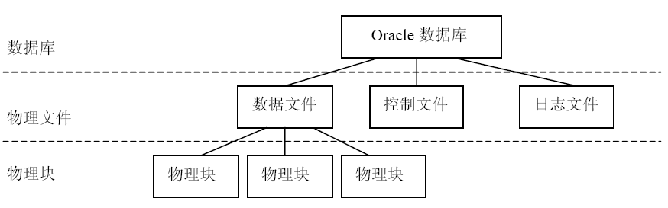
Oracle physical structure
Datafiles (belongs to Tablespace)
Chunks

Slide 69
To begin with Oracle …
Schema
  In Oracle, schema is similar to a “user”, but the concept is more general.
  Different from the “schema” in “relation schema”
Logging in
  A built-in DBA schema “SYSTEM”
  Log in as SYSTEM
  Create your own schema
    create user <username> identified by <password>
    default tablespace users temporary tablespace temp;
  Grant privileges
    grant connect, resource to <username>;

Slide 70
To begin with Oracle …
COMMIT/ROLLBACK
  You may execute any queries via a database client.
  But you have to do COMMIT if you want to make your modifications persistent.
  Before you do COMMIT, you may ROLLBACK any modifications you’ve done to database.
  More on this in later lectures

Slide 71
Query Tips
Tuple Variables
    select distinct T.branch_name as BN
    from branch T, branch S
    where T.assets > S.assets and
    S.branch_city = 'Brooklyn'
Set operations
(select customer_name from depositor)
minus
(select customer_name from borrower);
No Unique support
  Use aggregation instead

Slide 72
ROWNUM
Find the names and assets of all branches, with ranks placed before them from the maximal branch to the minimal one
We can use ROWNUM to specify the serial number of every row appearing in the result set
  Pseudocolumn
  ROWID: a string with the format ‘BBBBBBBB.RRRR.FFFF’, where BBBBBBBB means the block number of the data file, RRRR means the row number in the block, and FFFF means the file number
  ROWNUM: decimal form of ROWID
We can also find the top N records with it

Slide 73
ROWNUM (Cont.)
select rownum,branch_name,assets
from (select branch_name,assets
from branch order by assets);
ROWNUM BRANCH_NAME ASSETS
---------- --------------- ----------
1 Pownal 400000
2 Mianus 400200
3 Central 400280
4 Downtown 900000
5 Perryridge 1700000
6 Redwood 2100000
7 North Town 3700000
8 Brighton 7000000
9 Round Hill 8000000
已选择9行。

Slide 74
ROWNUM (Cont.)
SQL> select rownum, branch_name, assets from branch order by assets;
ROWNUM BRANCH_NAME ASSETS
---------- --------------- ----------
6 Pownal 400000
4 Mianus 400200
9 Central 400280
1 Downtown 900000
3 Perryridge 1700000
2 Redwood 2100000
7 North Town 3700000
8 Brighton 7000000
5 Round Hill 8000000
已选择9行。

Slide 75
Tips of Oracle
How to find the duplicated records and delete them?
  We may use ROWID, subquery, and alias
  select ROWID, Some_Column from Some_Table A where A.ROWID!=(select max(ROWID) from Some_Table B where A.Some_Column=B.Some_Column);
  delete from Some_Table A where A.ROWID!=(select max(ROWID) from Some_Table B where A.Some_Column=B.Some_Column);

Slide 76
Tips of Oracle
How to get an auto-increasing sequence number?
create sequence MySequence
increment by 1
start with 1
maxvalue 999999999
cycle;
When inserting data into a table, you can:
insert into tablename values
(MySequence.nextval, …);
Find the current value of a sequence:
  select MySequence.currval from dual;

Slide 77
Tips of Oracle
How to change the name of a column in a table?
  Before Oracle 9i, we need to:
    create table New_Name(new_column_list) as select * from Old_Name;
    drop table Old_Name;
    rename New_Name to Old_Name;
  In v9.2 and later, syntax “alter table t rename column c to d” is supported.
By the way, to copy the structure of a table:
  Create table New_Name as select * from Old_Name where 1=2;

Slide 78
Tips of Oracle
Find what tables exist in a user schema:
  select table_name from user_tables;
Check columns in a table:
  describe Table_Name;
  desc Table_Name;
Find what views exist in a user schema:
  select view_name from user_views;
Check the definition of a view:
  select text from user_views where view_name=upper('VIEW_NAME');
Find what objects exist in a user schema:
  select * from tab;

Slide 79
Toolkits
SQL*PLUS
  A basic tool for querying
TOAD
  Third-party GUI
  A powerful administration tool
PL/SQL Developer
Golden

Slide 80
Practice
Environment: Oracle 10g/11g/12g
Try to
  Create tables in the Banking example.
    With scripts provided
  Drop/Add primary key
    Drop primary key of account
    Set primary key to account_name
  Drop/Add an attribute
    Add an attribute account_date to account, typed char(8)
    Drop attribute account_date
  View table structure (“desc”)
  Change an attribute (data type)

Slide 81
Practice (cont.)
Try to
  Insert tuples
  Delete tuples with conditions
  Update tuples with conditions
  Commit/Rollback
    Login a second time to find the effect of Commit/Rollback
  Execute example queries
Question
  Is it hard to insert rows one by one?
    Lab1

Slide 82
Next Lecture
Advanced SQL and Other Relational Languages

Slide 83
End of
Lecture 3
SQL

